Slide 1
Coding Legal Apps
An introduction to rule-based AI in law
Graham Greenleaf & Philip Chung
UNSW Faculty of Law
30 May 2019
DataLex inferencing software by
Andrew Mowbray
UTS Faculty of Law

Slide 2
Aims
Which types of AI suit most applications to law? What implications does this have?
Introduce rule-based reasoning (backward and forward chaining)
Key elements in building DataLex KBs (knowledge-bases)
Practice: building your own small KB
After today: How to further develop KB skills

Slide 3
DataLex & AustLII – Background
Now in another wave of ‘AI & law’ – this is not all new
  1st wave (50s & 60s): attempt to find ‘building blocks of intelligence’
  2nd wave (early 70s to mid-90s): ‘expert systems’ and logic programming; ended with 2001 dot.com crash; a long ‘AI winter’ followed
  3rd wave (2010? ‘big data’ –): neural networks & ML; still cresting…
DataLex Project (1984-2001) was part of the 2nd wave – see history in ‘substainable’ paper – an approach learned from experience
New DataLex Project (2017-) is AustLII’s future role in AI
  further developing DataLex inferencing tools to build legal KBs;
  Integrating these tools with all forms of content on AustLII
  assisting users to build and maintain sustainable free legal advisory systems
  providing ‘AI infrastructure’, rather than directly building applications
AustLII is assembling the DataLex Web within AustLII Communities
  location of most resources used in this course
  start with a quick demonstration of what we are aiming to do today

Slide 4
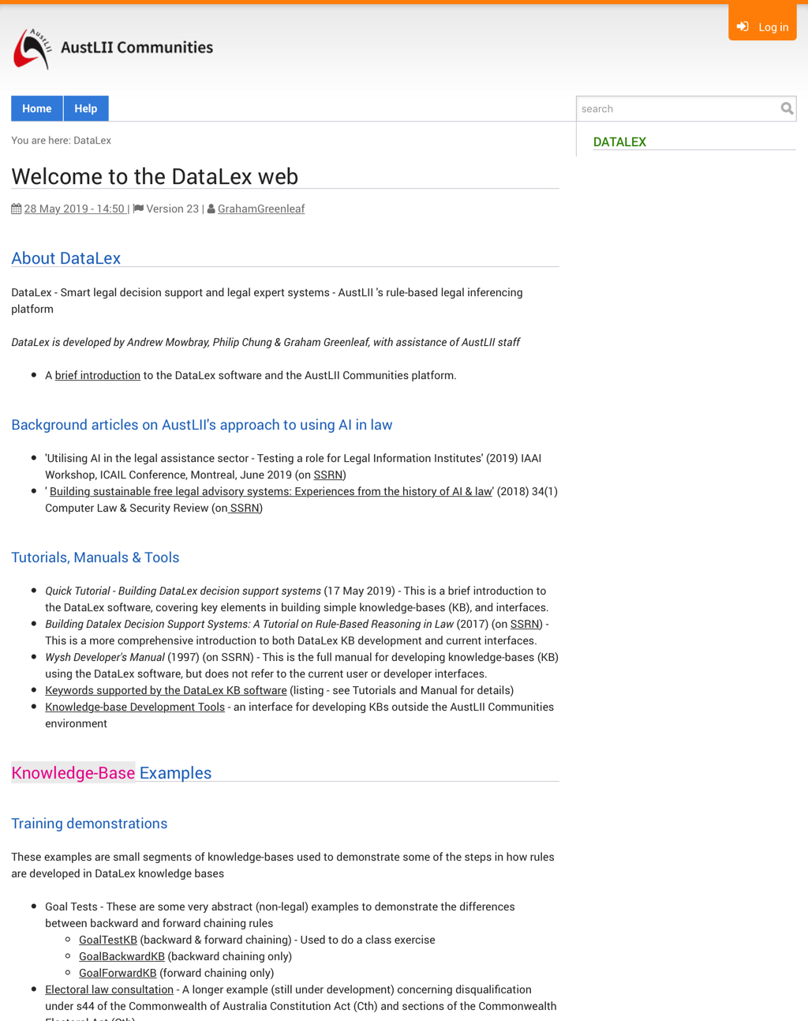
DataLex within AustLII Communities
http://austlii.community/wiki/DataLex/

Slide 5
15 principles for sustainable legal apps
‘Sustainable’ article suggests 15 ideas that still seem to make sense from the perspective of sustainable free legal advisory systems
  See ‘Class exercise: Principles for development…’
Three themes in AustLII’s approach, are the need for:
  Explanations based on the sources of law (1-5)
  Self-sufficiency by legal advice providers (6), (15)
  Transparency between code and sources, in both the underlying KB, and the app in operation (7-14)
A quick introduction to these arguments…

Slide 6
Summary: 15 principles for sustainable legal app development
Law is not ‘just another problem domain’
Expertise is relative
No AI tool suits all types of problems
Start with legislation, not case law
Aim to handle complexity
Users organisations should maintain their own knowledge-bases
Use declarative knowledge representations where possible
Isomorphism is desirable
Quasi-natural-language knowledge-bases avoid repetitive coding
Propositional representation is enough for most tasks
Inferencing is not enough for decision support
Semi-expert systems and users collaborate
Legal expertise can and should be captured by multiple means
Automate hypertext linking, and searches, from knowledge-bases
Collaborative knowledge-bases can. Rows –sources development

Slide 7
1. Law is not ‘just another problem domain’
Law is a difficult and unusual problem domain
  Unique relationship b/w legal sources and reasoning
At least 5 types of legal expertise may be modeled: (i) formal advice; (ii) strategic advice; (iii) document generation; (iv) smart litigation/transaction systems; (v) smart retrieval
DataLex approach focuses on (i) formal legal advisory systems: conclusions supported by legally convincing reasons based on sources.
  DataLex primarily uses ‘symbolic AI’ (supplemented by procedural document generation, data mining and NNDA)
  models (ii), (iv) & (v) are more likely to use ‘connectionist’ tools (neural nets, machine learning + very big data sets)

Slide 8
2. Expertise is relative
‘Expert’ depends on context
  resource limitations define ‘expertise’ by context
    Including both legal and computing expertise
  particularly applicable to free advice providers
  assumption behind the DataLex approach
‘This problem appears to be beyond the expertise of this system’
  successful advice, triaging human expertise to where needed most
  many system should include this at some point

Slide 9
3. No AI tool suits all types of problems
Fundamental question:
  is prediction of a ‘correct’ (useful) answer sufficient?
  or are justifications based on legal sources required?
Answer determines which types of tools can be used.
  machine learning (ML), neural networks etc cannot as yet explain their answers in human terms
  Eg automated document discovery systems, based on ML, can work well because
    they only need to predict if a document is likely to be relevant, but not explain why;
    training sets (with labels as to relevant / irrelevant) are affordable to produce

Slide 10
Eg Machine learning [ML] is rarely relevant to legal advice / decision support systems
Micha Grupp (Law, Frankurt U.) ‘The factors that have fueled the AI-discussion in the last 7 years are of (almost) no relevance for AI in law.’ He says there are 5 ways in which ‘We do NOT have the necessary data for training legal machine learning algorithms’ for …
‘Formalization’ – We cannot formalise most legal terms.
‘Labels’: eg photo recognition software only works if photos come with labels; ‘Training sets’ require labels and are costly.
‘Data Quality’: eg contracts made under different laws are useless; ditto decisions under different regs.
‘Ontological Data’: There are no accepted ontologies for law, even though we have complex hierarchies in our heads.
‘World Knowledge’: Applying law requires unpredictable amounts of real-world knowledge.
MichaGrupp ‘25 facts about AI & Law you always wanted to know (but were afraid to ask)’ Medium, 7 April 2019
BUT some argue that very large data sets and new algorithms may overcome these ‘knowledge acquisition bottlenecks’, even in law
AustLII’s LawCite uses ML

Slide 11
4. Start with legislation, not case law
Can sustainable free access systems use case-based reasoning?
  A principal focus of AI & law research for 40 years (see 15 vols of ICAIL Proceedings 1987-2017)
  Theoretical basis still in dispute, no agreed approach
  Identification/encoding of attributes in cases is costly;
    Encoding methods may apply only to narrow areas of law
    Ashley’s ‘cognitive computing paradigm’ assumes that a significant corpus of cases is available from which attributes can be extracted
DataLex approach is pragmatic, with 3 alternatives:
  Most practical: use links/searches over AustLII to alert users when case-based reasoning is required, and assist them to get to the cases needed to resolve a question.
  Represent definitive cases as rules, with links to supporting texts
  PANNDA approach (Tutorial part 12) of reasoning from examples in very specific areas – but with links to cases for & against essential

Slide 12
Extract from Finder’s Cases KB (DataLex PANNDA)
EXAMPLE Armory v Delamirie [1722] EWHC KB J94 PROVIDES
the finder wins ONLY IF
the finder was not the occupier of the premises AND
the chattel was not attached AND
the non-finder was not the owner of the real estate AND
the non-finder was not the owner of the chattel AND
there was a bailment of the chattel AND
there was not a term in a lease which mentioned found items AND
there was not a master-servant relationship between the parties AND
the chattel was not hidden AND
there was not an attempt to find the true owner of the chattel AND
there was prior knowledge of the existence of the chattel
EXAMPLE Bridges v Hawkesworth (1851) 21 LJQB 75 PROVIDES
the finder wins ONLY IF
the finder was not the occupier of the premises AND
the chattel was not attached AND
the non-finder was the owner of the real estate AND
… [ATTRIBUTES CONTINUE]

Slide 13
5. Aim to handle complexity
Good to start with simple problems, BUT
Computers can out-perform humans in handling (some) complexity in a thorough way
  complexity is the boring part of expertise
  ‘capture complexity once only’ is a good aim
Rule-based reasoning can be ideal for this
Examples
  15 ways the Privacy Commissioner can avoid making a decision (later)
  many ways to be ineligible for election under s44 …

Slide 14
Extract from Constitution Act s44 KB (DataLex)
RULE Constitution - Section 44 PROVIDES
section 44 of the Constitution applies ONLY IF
section 44(i) of the Constitution applies OR
section 44(ii) of the Constitution applies OR
section 44(iii) of the Constitution applies OR
section 44(iv) of the Constitution applies OR
section 44(v) of the Constitution applies
RULE Constitution - Section 44(i) PROVIDES
section 44(i) of the Constitution applies ONLY IF
the nominee is under an acknowledgment of
allegiance, obedience, or adherence to a
foreign power OR
the nominee is a subject of a foreign power OR
the nominee is a citizen of a foreign power OR
the nominee is entitled to the rights or
privileges of a subject or a citizen of a
foreign power

Slide 15
6. Users organisations should maintain their own knowledge-bases
Expert systems paradigm = domain expert(s) + knowledge engineer + KB program (shell)
  But Knowledge Engineers were rare & expensive
The Knowledge Acquisition Bottleneck
  the key problem of previous AI &Law
    Time/cost to capture legal expertise in obscure formalisms
    Time/cost to update expertise when law (frequently) changes
  Endemic, except if ML/training sets apply
Becomes desirable/necessary for lawyers to build/maintain their own knowledge-bases
  Particularly for those with limited financial resources
  May also overcome the timeliness problem
The question then is: How is it possible in practice to reject the expert system paradigm?
-> 7-15 suggest how

Slide 16
7. Use declarative knowledge representations where possible
Declarative knowledge representations (KBs): state domain knowledge as rules, but not the order of application
  The program (shell) determines the order of rule evaluation
  Contrast: Procedural knowledge representations combine domain knowledge +its order of application
Declarative KBs are preferable wherever possible for law
  Legal procedural steps may be best as procedural code
  Document generation (Tutorial part 11) also requires them
  Complex KBs: likely to be mainly declarative, partly procedural
Declarative rules in KBs are evaluated by:
  Backward chaining rules: a goal is specified and the program evaluates rules in the order that will most efficiently give a value for the goal
  Forward chaining rules: all known facts are applied to evaluate rules until a value for the goal is obtained, or the facts are exhausted
  Evaluation may be simultaneously backward and forward chaining (DataLex)

Slide 17
Class Exercise
‘Simple backward and forward chaining rules’
DataLex ‘Goal Tests’ provides three examples
GoalBackward (back chaining only)
  Work out if D is true, on the facts given; note which rules you evaluate, in which order
  Compare the order in which DataLex does so
Goaltest (forward and backward chaining)
  Why does DataLex say C true when E is true?
GoalForward (forward chaining only)
  Make sure to answer questions in UPPER CASE (a bug)
Note: DataLex’s order of evaluation is
  top-down, including when two rules have the goal
  L -> R within a rule, even if unnecessary (no ‘look ahead’)

Slide 18
‘Goaltest’
Rule Conditions Conclusion
Rule 1 E and F A
Rule 2 A and (B or C) D
Rule 3 E or G C
Rule 4 H and G and C and not F A
Rule 5 F and not E not D
Facts
E, H and G are correct (true)
F and B are not correct (false)

Slide 19
Examples of a declarative & a procedural rule
GOAL RULE Eligibility for Nomination to Federal
Parliament PROVIDES
the nominee is entitled to be nominated for election
to federal parliament ONLY IF
the nominee is entitled to be nominated under
section 163 of the Commonwealth Electoral Act
1918 AND
section 164 of the Commonwealth Electoral Act 1918
does not apply AND
section 44 of the Constitution does not apply
GOAL DOCUMENT Last Will & Testament PROVIDES
IF the person making the Will is legally capable of
making a Will THEN
BEGIN
CALL Disclaimer
CALL Preamble
CALL Revocation
CALL Contemplation of Marriage
CALL Sole Beneficiary
CALL Attestation
END
ELSE the person making the Will should not make a Will

Slide 20
8. Isomorphism is desirable
Isomorphism: as close as possible to a one-to-one correspondence between legal sources and knowledge-base (KB)
  It is only an ideal, can never be achieved fully
Advantages: essentially Qs of transparency
  Easier for legal experts to audit whether the KB is an acceptable representation of the law
  When law changes, easier to identify which part of KB to change
  As KB becomes more complex, isomorphism becomes more valuable
Example: Copyright Law KB (out of date)

Slide 21
Extract from (somewhat) isomorphic KB
RULE Copyright Act 1968 - s29(1) PROVIDES
s29(1) applies ONLY IF
s29(1)(a) applies OR
s29(1)(b) applies OR
s29(1)(c) applies
RULE Copyright Act 1968 - s29(1)(a) PROVIDES
s29(1)(a) applies ONLY IF
the work is a literary work AND/OR
the work is a dramatic work AND/OR
the work is a musical work AND/OR
the work is an artistic work AND/OR
the work is a published edition AND
reproductions of the work have been supplied
(whether by sale or otherwise) to the public
RULE Copyright Act 1968 - s29(2) PROVIDES
reproductions of the work have been supplied (whether by sale or otherwise) to the public ONLY IF
reproductions of the whole of the work have been supplied (whether by sale or otherwise) to the public
/* Added to give effect to: (2) In determining, for the purposes of paragraph (1) (a),
whether reproductions of a work or edition have been supplied to the public, section 14 does not apply.
*/
RULE Copyright Act 1968 - s29(1)(b) PROVIDES … [TEXT CONTINUES]
COPYRIGHT ACT 1968 - SECT 29
Publication
(1) Subject to this section, for the purposes of this Act:
(a) a literary, dramatic, musical or artistic work, or an edition of such a work, shall be deemed to have been published if, but only if, reproductions of the work or edition have been supplied (whether by sale or otherwise) to the public;
(b) a cinematograph film shall be deemed to have been published if, but only if, copies of the film have been sold, let on hire, or offered or exposed for sale or hire, to the public; and
(c) a sound recording shall be deemed to have been published if, but only if, records embodying the recording or a part of the recording have been supplied (whether by sale or otherwise) to the public.
(2) In determining, for the purposes of paragraph (1)(a), whether reproductions of a work or edition have been supplied to the public, section 14 does not apply.

Slide 22
9. Quasi-natural-language knowledge-bases avoid repetitive coding
Symbolic representations have disadvantages
  Legal experts cannot audit/understand them
  Both dialogues (questions) and explanations/conclusions are separate from the KB; isomorphism is largely lost
  These can all get ‘out of synch’, particularly when the law changes
Alternative: quasi-natural language representations
  Tutorial parts 4, 6 & 7 explain this
  Faster to develop, as no repetitive coding; other advantages come from higher isomorphism
  Example: run the FOI consultation, testing run-time options, and the two forms of checks (Tutorial part 7)

Slide 23
Examples of dialogue & explanations generated automatically from s29 code (previous slide)
1) What is the name of the work ?
> The Lord of the Rings
2) Is The Lord Of The Rings a literary work ?
> Why?
This will help determine whether or not s29(1)(a) applies.
2) Is The Lord Of The Rings a literary work ?
> Yes
3) Have reproductions of the whole of The Lord Of The Rings been supplied (whether by sale or otherwise) to the public ?
> Yes
4) Is the publication merely colourable (not intended to satisfy the reasonable requirements of the public) ?
> No
5) Is the conduct relied upon to constitute publication the performance of The Lord Of The Rings ?
> No
6) Is the conduct relied upon to constitute publication the supply (whether by sale or otherwise) to the public of records of The Lord Of The Rings ?
> Why?
This will help determine whether or not the conduct relied upon to constitute publication is listed in s29(3).

Slide 24
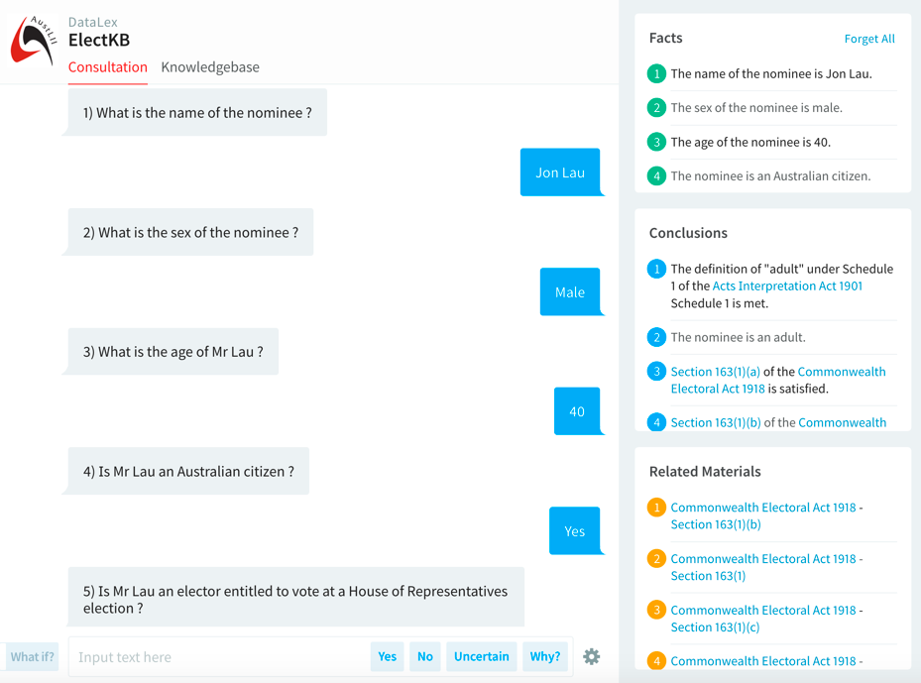

Slide 25
10. Propositional representation is enough for most tasks
Predicate calculus, where multiple instances of the same variable can have different values, is only infrequently required.
  Very difficult for legal experts to understand / modify
Others (eg Bench-Capon) have similarly concluded that propositional logic is sufficient for most types of legal reasoning.
DataLex software allows use of variable attributes (Manual 2.12) which are similar to some limited aspects of predicate (1st order) logic

Slide 26
11. Inferencing is not enough for decision support
Interpretation issues cannot be eliminated from knowledge-bases (KBs)
  Rule-based reasoning is rarely sufficient
So inferencing systems cannot be ‘closed’
  must allow & assist users to access legal sources, to interpret where required
  must allow & assist users to check if law has changed since the KB was written

Slide 27
12. Semi-expert systems and users collaborate
‘Robot lawyers’ are a misconception
Real model is a legal decision support system
  collaboration between a semi-expert computer system, and a semi-expert user
  control of a problem’s resolution alternates between them
System design, and extent of reliance on the user’s expertise, depend on extent of expertise of the intended/likely users.

Slide 28
13. Legal expertise can and should be captured by multiple means
Knowledge-bases (KBs) are not the only form of capturing legal expertise (but may be the most sophisticated)
All technologies for utilising legal information allow legal expertise to be stored and re-used
  Traditional: citators, textbooks etc
All available new technologies (eg text retrieval, hypertext) should be utilised to store and re-use appropriate expertise
  Links from KBs in operation to sources/commentary , & stored searches to find updates, are embodied expertise
Integration between KBs and other forms of stored expertise, transparent to users, is the key to effective ‘open-ended’ apps

Slide 29
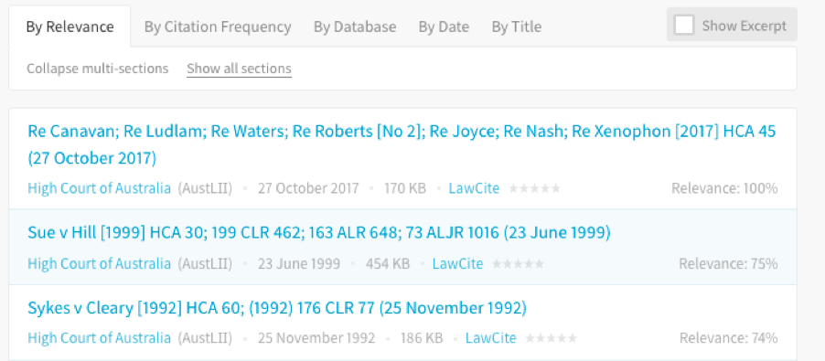
Constitution s44 KB – results of embedded search for direct or indirect pecuniary interest

Slide 30
14. Automate hypertext linking, and searches, from knowledge-bases
Hypertext links and stored searches from dialogues and explanations increase user ability to answer questions and understand explanations
  to definitions, cases, citators, commentary etc
  can be both automated and hand-crafted.
Run the FINDER application (Tyree, Mowbray)
  Although law is pre-1987, links to LawCite citator allow up-to-date cases to be found.

Slide 31
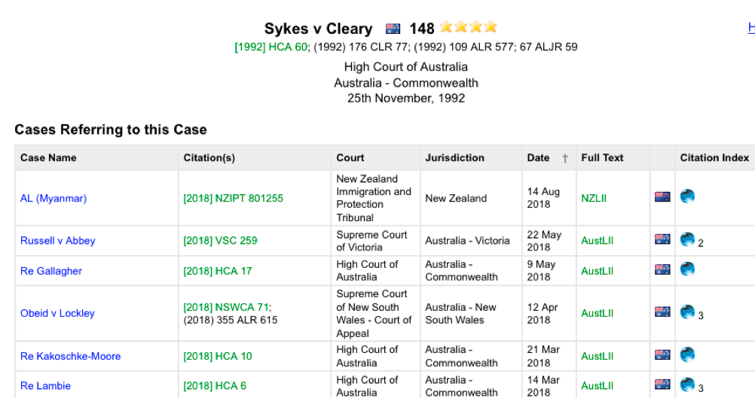
Constitution s44 KB – embedded link to Sykes v Cleary, then to LawCite showing cases later than KB

Slide 32
15. Collaborative knowledge-bases can crowd-source development
Parts of knowledge-bases can be distributed across different websites
  invoked remotely as part of a consultation
  Helps distribute maintenance and development costs of complex knowledge-bases
DataLex ‘INCLUDE’ feature allows this
  Quick Tutorial part 7 ‘Cooperative inferencing’
  Examples using INCLUDEs are Privacy Act 1988 (Cth) procedures consultation
  Freedom of Information consultation

Slide 33
Summary: 15 principles for sustainable legal app development
Law is not ‘just another problem domain’
Expertise is relative
No AI tool suits all types of problems
Start with legislation, not case law
Aim to handle complexity
Users organisations should maintain their own knowledge-bases
Use declarative knowledge representations where possible
Isomorphism is desirable
Quasi-natural-language knowledge-bases avoid repetitive coding
Propositional representation is enough for most tasks
Inferencing is not enough for decision support
Semi-expert systems and users collaborate
Legal expertise can and should be captured by multiple means
Automate hypertext linking, and searches, from knowledge-bases
Collaborative knowledge-bases can. Rows –sources development

Slide 34
Class exercise:
Which of these 15 ‘principles’ are relevant?
Use the handout, article and PPTS to discuss the following, in groups of 3 or so (10 minutes):
  Which of these 15 points are likely to be relevant to the development of legal apps that you might undertake (irrespective of which software you use), and which are not relevant? Why is that?
  Are there other general principles you would suggest should be added to any list of general principles for the development of applications?
  How different are principles relevant to assisting organisations providing free legal advice services likely be from those relevant to commercial or government organisation?

Slide 35
Demonstration of DataLex app development - Privacy procedures
Choice of problem domain:
  The Australian Privacy Commission can only make binding decisions (including compensation) on complaints about privacy under s52 Privacy Act 1988. But he/she only makes an average of 2 p/a (last 5 years).
  Appeals against s52 decisions to the Administrative Appeals Tribunal are possible under s96 Privacy Act.
  But first it is necessary to avoid having the Commissioner dismiss a complaint before making a decisions, or otherwise find a reason for not making a s52 decision.
The aim is therefore to develop an app which will advise on how to ensure that the Commissioner makes a s52 decision that can be appealed.

Slide 36
A set of facts to test the Privacy app
Tina Thumb applied for a personal loan from Payday Lenders Pty Ltd (‘Payday’) in July 2018. They required her to disclose sensitive information including her fingerprints. She complained immediately to them, but has still received no reply. There is no mediation service for these types of loans. She then complained to the NSW Dept of Consumer Affairs, but they have not replied. Their legislation does not provide for the award of damages. After six months she complained to the Privacy Commissioner, and has answered all their enquiries. Tina’s lawyer advises that the Privacy Act is the most appropriate law for her complaint, and that the facts give a high likelihood that Payday has breached the Act.

Slide 37
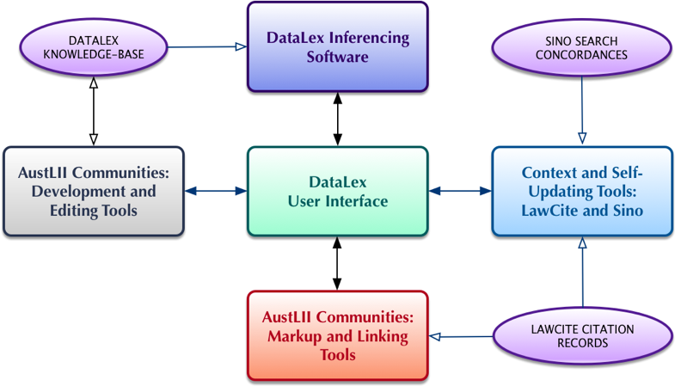
The DataLex system within AustLII Communities

Slide 38
Building a DataLex test app
Use the Quick Tutorial, and (where necessary) the full Tutorial, and the Manual
Start development at the Knowledge-base Development Tools (KB Tools) page
  http://www.datalex.org/dev/import/
Import a key section of the Act on which your app is based, and start editing it to make one rule
  ‘Comment out’ the rest of the section (/* … */)
  Use ‘Run Consultation’ asap, to check the rule works
  Use ‘Check Fact Cross References’ and ‘Check Fact Translations’
  Go back to the KB Tools page: fix and test; then add another rule

Slide 39
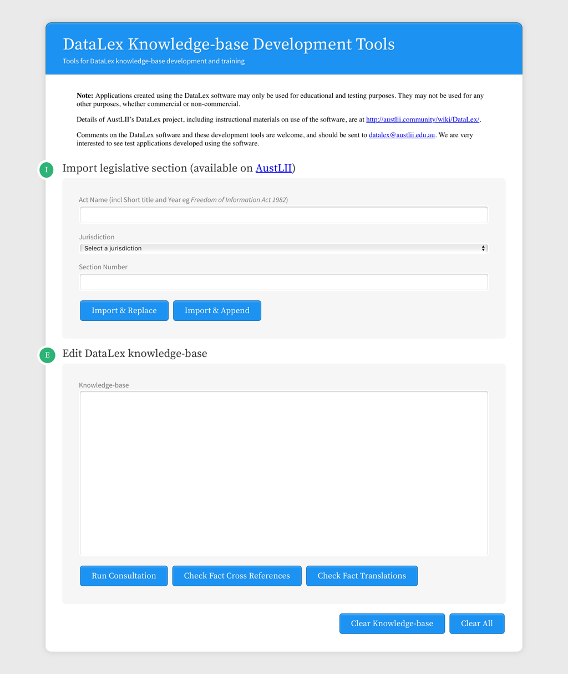
DataLex Knowledge-base Development Tools
http://www.datalex.org/dev/import/

Slide 40
Building a DataLex test app (cont.)
Try to add the following features to your app.
  At least one Keyword in addition to ONLYIF
  Make at least one rule a GOAL RULE
  At least one Named Subject (PERSON, THING etc)
  Include the full Act Name (including year) and section, in a rule, so as to automatically create a link to it
  Use LINK … TO … to manually create another link
  Look at the Manual, to find more Keywords that would be useful
Copy the text of your app from the KB Tools page to a Word file, email, or other method of keeping a copy, in case you want to use it again.

Slide 41
What can you do next with DataLex?
Continue developing test apps using the Development Tools page
  Limited AustLII email assistance with queries is available for CLE attendees
Obtain email updates on new DataLex tools, documentation, articles and training
  Please complete the DataLex feedback form
If if significant projects using DataLex are desired, discuss with AustLII obtaining a log-in to the DataLex pages on AustLII Communities
  Projects can be saved, and other advantages

Slide 42
References
AustLII Communities: DataLex http://austlii.community/wiki/DataLex/ – key DataLex papers, manuals etc
Greenleaf, Mowbray & Chung, ‘The Datalex Project: History and Bibliography’ (2018) https://ssrn.com/abstract=3095897
  or see linked bibliography at http://www2.austlii.edu.au/~graham/expert_systems.html
Kevin Ashley Artificial Intelligence and Legal Analytics (Cambridge, 2017)

Slide 43
Questions and feedback
Graham Greenleaf - graham@austlii.edu.au
Philip Chung - philip@austlii.edu.au
General DataLex feedback - datalex@austlii.edu.au

