Slide 1
The Copyright Public Domain: Its importance and breadth
Graham Greenleaf Professor of Law & Information Systems, UNSW Australia; Co-founder, AustLII
Australian Digital Alliance Conference, 22 March 2019

Slide 2
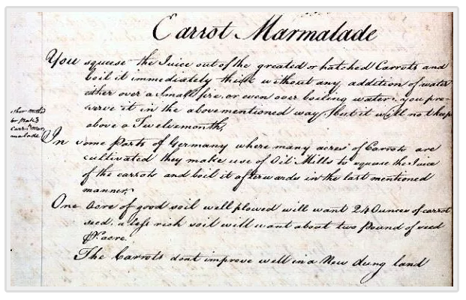

Slide 3
Importance of the public domain: A very broad view
If the public domain includes all the uses that we can make of works and their subject matter, without obtaining the permission of a copyright owner, then there is much for an organisation like ADA to value, defend, and work to extend.

Slide 4
15 categories of the public domain
1 | works failing minimum requirements
2 | works impliedly excluded
3 | works expressly excluded
4 | constitutional and related exclusions and exceptions
5 | works in which copyright has expired
6 | public domain dedications
7 | public policy refusals against enforcement
8 | works failing minimum requirements
9 | insubstantial parts
10 | ideas or facts
11 | uses outside exclusive rights
12 | free use exceptions and limitations
13 | neutral compulsory licensing
14 | neutral voluntary licensing
15 | de facto public domain of benign uses
+ | Various supports for, and constraints on, public domains

Slide 5
Why we value the public domain
This broad view more clearly reveals that there are many of our values that the public domain supports, including:
Creativity – Creators invariably draw on the public domain to create new works – a virtuous circle;
It is essential to our acquiring knowledge, past & present;
It is a basis of cultural participation at all levels;
Freedom of speech and communication cannot always be subject to another’s permission;
Democracy depends on all these relatively uninhibited flows of information;
So both individual autonomy and public life are enhanced.
But what © protects is just as important in advancing these values. The balance between © protection, and the limits imposed by the public domain must be maintained.

Slide 6
Avoiding ‘tragedy of the commons’
Elinor Ostrom won a Nobel Prize for economics by showing that careful and principled governance could defeat the alleged ‘tragedy’ of land held in commons, and other ‘common pool resources’ (CPR).
The same approach can apply to commons in information, through careful governance built on copyright law and institutions. Our categories (13)-(15) illustrate this.

Slide 7
Neutral voluntary licensing
FOSS (Free & Open Source Software) since the 1980s, and Open Content (particularly Creative Commons since 2001)
Vast expansion of the public domain
Based on © continuing to exist in the works licensed
Vigilant curation & protection of licence conditions, by CC, FSF, OSI etc
No recognition or assistance in legislation
The EU’s © Digital Single Market Directive (nearing completion) has three provisions facilitate legal recognition of voluntary licensing
Rightholders must have right to grant royalty-free licences
Exception from fair & proportionate remuneration where author grants a non-exclusive right of free use to all
Right to revocation of publishing licences essential to allows authors to place out-of-commerce works (OOCW) under voluntary licences

Slide 8
Neutral voluntary licensing

Slide 9
Neutral compulsory licensing
Australia has more statutory compulsory licensing than most countries; less extended collective licensing (ECL) than much of Europe; both are aspects of the public domain
We all obtain great benefits as the end-users of the works covered by these licences, in education, culture and elsewhere. And many of us do as the intermediaries – educators, librarians – who use these works for public benefit
Perhaps we need more compulsory licences, to enable use of Orphan Works, Out-of-Commerce Works (OOCW), and GLAM collections
But we need more inclusive governance of the administration of these parts of the public domain, to reflect the interests of Collecting Society (CS) members, non-members, and the users who benefit from them
Useful aspects of the EU’s © Digital Single Market Directive
If an appropriate voluntary licence for OOCW exists with a CS, it will convert into an ECL (thus affecting all relevant works)
Transparency required in exploitation of compulsory licences
An important part of ADA’s role can be to strengthen good governance of this vital part of the public domain

Slide 10
De facto public domain of benign uses
‘Free access’ is not open content, but can help create de facto public domains. It generally supports the public domain.
It only works when it is not against the interests of the © owners (‘benign’)
Most of AustLII’s legislation, case law, and journal articles are ©, but are in the de facto public domain for most non-republishing uses.
some content in the public domain by law or open licence.
Other LIIs are a similar mix.
AustLII = 25 years of curation of a commons:
cooperation with data sources to secure free access data flows;
blocking general search engines from case law;
not profiting from surveillance of users;
technological value-adding to generate financial sustainability
Other huge resources such as the NL’s TROVE are a similar combination of public domain types & careful curation.

Slide 11
Is free access always a friend?
Since Alta Vista (1997), all general search engines have created the largest de facto public domain in history: the searchable web
BUT Google (2000) and Facebook (2003) invented & dominate surveillance capitalism, which becomes more intense & dangerous every year
Dilemma 1: Is free access which is not free from excessive surveillance still a valuable part of the public domain?
OR is manipulation of our lives, and of democracy, a negation of the liberty that is the purpose of the public domain?
Dilemma 2: Should digital policy organisations always treat those responsible for surveillance capitalism as allies? Is it time for a re-think?
Last 20 years: seen as libertarian allies
Are they still appropriate sources of funding?

