Slide 1
Today’s programme
Please introduce yourself to the class in a minute or less
  Name + anything you like: where you work?; interest in AI?
Time | Activity
9:00 – 10:00 (70 min) | Brief history of AI; Basic principles of rule-based reasoning in law
10:00 – 10:50 | Representing legal knowledge with the DataLex software
refreshment break
11:10 – 12:15 | Using the DataLex Developer’s Tools
12:50 – 1:15 | Developing your own test app

Slide 2
Coding Legal Apps
An introduction to rule-based AI in law
Graham Greenleaf & Philip Chung UNSW Faculty of Law
30 November 2021
Andrew Mowbray
UTS Faculty of Law

Slide 3
Aims
Theory
  What are the landmarks in the history of AI?
  Which types of AI suit most applications to law?
  Introduce rule-based reasoning (backward and forward chaining) and other forms of symbolic representation of law (chatbots, document generation)
Practice
  Key elements in building DataLex apps: (i) writing legal code-bases + (ii) integrating them with AustLII resources
  Demonstration: How to build your own small app
  Practice: Hands-on to build & test your own apps using the DataLex KB tools, software and AustLII resources

Slide 4
Artificial intelligence: Brief history
1950s – aim to create general intelligence (‘strong AI’)
  Always fails (‘easy things are hard’: Minsky) – cup of coffee?
  Supporters keep claiming it is imminent (‘singularity’)
  AI successes are still in ‘weak/narrow AI’ – expert domains
Split between two main schools of AI at that time
  Symbolic AI : rules (symbolic logic) manipulating symbols of real entities; suits high level language and logical tasks;
    Statistical AI: An intermediate stage more than a third paradigm?
  Sub-symbolic AI: simulations of neurons, with multiple inputs (weighted) resulting in one composite output which ‘fires’ once over a set threshold; suits ‘low level perceptual tasks’; now ‘machine learning’ (ML)
  Symbolic AI dominant until 90s, sub-symbolic (neural nets) since then.

Slide 5
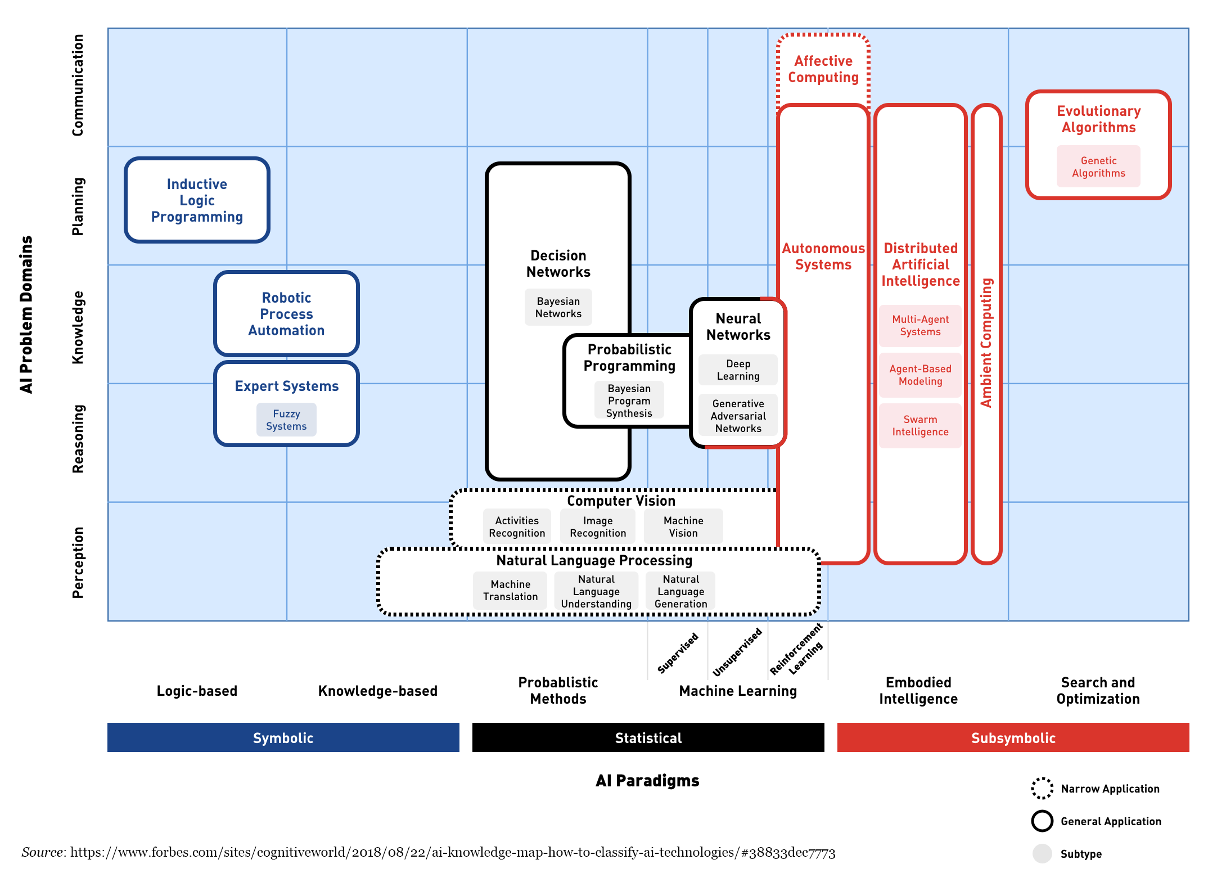
3 AI paradigms (one of many diagrams)

Slide 6
Artificial intelligence: Brief history (2)
3 innovations explain rise of neural networks since mid-1980s
  New techniques – Multi-layered neural networks + ‘back propagation’ of fault, worked on more tasks; but no ability to explain results (now ML)
  More processing power – ‘Parallel distributed processing’ (90s) onward
  Big data – enhanced by vast post-Internet (1995) data sources for training sets, and real tasks; made machine learning (ML) industrial scale
Landmarks in neural networks and ML (most since 2010)
  NOT 1997 IBM’s Deep Blue beat Kasparov at chess (brute force); 2011 IBM’s Watson won Jeopardy! (smart retrieval) – best known AI but minor effect
  2012 Convolutional neural networks (ConvNets) won ImageNet competition, revolutionised image recognition
  2012 automated speech recognition using multiple deep neural nets –> first great natural language processing (NLP) success
  2016 ‘neural machine translation’ (Swiss) replaced Google, Microsoft etc

Slide 7
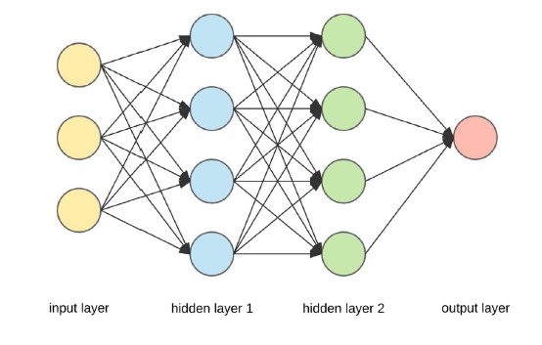
Neural network with two hidden layers
(Figure by A Dertat, cited in Legg & Bell, p10)
Inputs are weighted
Outputs ‘fire’ if exceed set threshold

Slide 8
References – Introductions
Greenleaf & Chung Readings on AI and on 'AI & Law'
Introductions to AI
  Melanie Mitchell Artificial Intelligence – A Guide for Thinking Humans (Pelican 2019)
  Margaret Boden Artificial Intelligence – A Very Short Introduction (OUP 2016)
AI and law
  Kevin Ashley Artificial Intelligence and Legal Analytics (Cambridge, 2017) – emphasis on case-based reasoning
  Michael Legg & Felicity Bell Artificial Intelligence and the Legal Profession: A Primer (flipstream, UNSW Faculty of Law, 2018)
Textbook on AI techniques (advanced)
  S Russell and P Norvig Artificial Intelligence: A Modern Approach (3rd Ed) (Pearson, 2016) (Ch 1 is an introduction; final chapter also valuable)

Slide 9
DataLex & AustLII –
From ‘expert systems’ to ‘Rules as Code’
DataLex Project (1984–) predates AustLII (1995 –)
  Developed AI tools for law in the pre-Internet ‘expert systems’ era
New DataLex Project (2017-) is AustLII’s future role in AI: ‘Rules as Code’
  Further developing DataLex inferencing tools to build legal KBs
  Integrating these tools with all forms of content on AustLII
  Assisting users to build and maintain sustainable free legal advisory systems
  Providing ‘AI infrastructure’, rather than directly building applications
The DataLex Community is part of AustLII Communities
  Location of most resources used in this course
  Start with a quick demonstration of what we are aiming to do today: ELECTKB
  After today, you can develop and test your own apps with any of these features

Slide 10
DataLex ‘ElectKB’ demo
The code= base (KB) = symbolic AI (now the minority in AI); propositional logic (origin: Aristotelian logic + c20th processing)
It is essentially a set of rules, + a few extras
The ‘inferencing’ is primarily goal-directed, backward-chaining; but also forward-chaining
Isomorphism: put ‘gear wheel’ on to view rule evaluation
This KB is the only code producing the consultation for this application: no separate questions or explanations
Integration with AustLII, LawCite etc is crucial
For discussion, see Mowbray, Chung & Greenleaf 'Utilising AI in the legal assistance sector - Testing a role for LIIs' (on SSRN) (2019)
For DataLex tools, see ‘Law as Code: Introducing AustLII’s DataLex AI’

Slide 11
15 principles for sustainable legal apps
DataLex article ‘Building Sustainable Free Legal Advisory Systems: Experiences from the History of AI & Law’ (2017)
This article suggests 15 ideas that remain relevant to building sustainable free legal advisory systems
  Many of them are also relevant to developing commercial systems
Three themes in this approach are the need for:
  Explanations based on the sources of law (1-5) – when running
  Self-sufficiency by legal advice providers (6), (15) – when developing
  Transparency between code and sources, in both the KB, and the app in operation (7-14) – for developing, updating & auditing
Headings of these 15 arguments follows… read article for details

Slide 12
Summary: 15 principles for sustainable legal app development
Law is not ‘just another problem domain’
Expertise is relative
No AI tool suits all types of problems
Start with legislation, not case law
Aim to handle complexity
Users organisations should maintain their own knowledge-bases
Use declarative knowledge representations where possible
Isomorphism is desirable
Quasi-natural-language knowledge-bases avoid repetitive coding
Propositional representation is enough for most tasks
Inferencing is not enough for decision support
Semi-expert systems and users collaborate
Legal expertise can and should be captured by multiple means
Automate hypertext linking, and searches, from knowledge-bases
Collaborative knowledge-bases can aid scaling-up

Slide 13
1. Law is not ‘just another problem domain’
Law is a difficult and unusual problem domain
  Unique relationship b/w legal sources and reasoning. Many other domains involve modeling physical laws or expertise about physical events. Legal sources are unique authoritative human artifacts, and do not (directly) model the physical world.
At least 5 types of legal expertise may be modeled:
  (i) formal advice on the correct interpretation of the law;
  (ii) strategic advice eg % chance of litigation succeeding;
  (iii) document generation, complying with the law;
  (iv) smart litigation/transaction systems;
  (v) smart retrieval and extraction from huge collections.

Slide 14
3. No AI tool suits all types of problems
Fundamental question:
  is prediction of a ‘correct’ (useful) answer sufficient?
  or are justifications based on legal sources required?
Answer determines which types of tools can most likely be used .
  machine learning (ML) / neural networks etc cannot as yet explain their answers in human terms; may be good at predicting results
    Dangerous to apply in decision-making systems; easily mis-used
  Eg automated document discovery systems, based on ML, can work well:
    they only need to predict if a document is likely to be relevant, but not explain why;
    training sets (with labels as to relevant / irrelevant) are affordable to produce

Slide 15
Eg Machine learning [ML] is rarely relevant to legal advice / decision support systems
Micha Grupp (Law, Frankfurt U.) ‘The factors that have fueled the AI-discussion in the last 7 years are of (almost) no relevance for AI in law.’ He says there are 5 ways in which ‘We do NOT have the necessary data for training legal machine learning algorithms’ :
‘Formalization’ – We cannot formalise most legal terms (eg ‘negligence’).
‘Labels’: eg photo recognition software only works if training photos come with labels; ‘Training sets’ require costly labels.
‘Data Quality’: eg contracts made under different laws are useless; ditto decisions under different regs.
‘Ontological Data’: There are no accepted ontologies for law, even though we have complex hierarchies in our heads.
‘World Knowledge’: Applying law requires unpredictable amounts of real-world knowledge [‘common sense’]
Micha Grupp ‘25 facts about AI & Law you always wanted to know (but were afraid to ask)’ Medium, 7 April 2019
BUT some argue that very large data sets and new algorithms may overcome these ‘knowledge acquisition bottlenecks’, even in law

Slide 16
Implications of Grupp’s arguments
Should not conclude we can’t do anything, but
  We can’t expect to fully automate KB construction
  We must allow for significant user input in system operation
  Good training sets will be expensive to build and difficult to map to raw data
    Case-based reasoning theorists (eg Ashley) have known this for 40 years
  How can you find large (training) data sets where both the labels and the outcomes can be determined automatically? (unsupervised learning)

Slide 17
6. User organisations should maintain their own knowledge-bases
Expert systems paradigm = domain expert(s) + knowledge engineer + KB program (shell)
  Lawyers assume to know nothing of KB construction, only of law
  But Knowledge Engineers were rare & expensive, + ignorant of law
The Knowledge Acquisition Bottleneck
  key problem of previous AI & Law
    Time/cost to capture legal expertise in obscure formalisms (Prolog; LISP)
    Time/cost to update expertise when law (frequently) changes
  Endemic, except if ML/training sets (labeling is costly) apply
Becomes desirable/necessary for lawyers to build/maintain their own knowledge-bases
  Particularly for those with limited financial resources
  May also overcome the timeliness problem
The question then is: How is it possible in practice to reject the expert system paradigm?
-> 7-15 suggest how

Slide 18
7. Use declarative knowledge representations where possible
Declarative knowledge representations (KBs): state domain knowledge as rules, but not the order of application
  The program (shell) determines the order of rule evaluation
  Contrast: Procedural knowledge representations combine domain knowledge +its order of application (eg ‘flow charts’; decision trees)
Declarative KBs are preferable wherever possible for law
  Legal procedural steps may be best as procedural code
  Document generation (Manual Ch 6) also requires them
  Complex KBs: likely to be mainly declarative, partly procedural
Declarative rules in KBs are by:
  Backward chaining rules: a goal is specified and the program evaluates rules in the order that will most efficiently give a value for the goal
  Forward chaining rules: all known facts are applied to evaluate rules until a value for the goal is obtained, or the facts are exhausted (they operate ‘silently’, don’t ask questions)
  Evaluation may be simultaneously backward and forward chaining (DataLex)
    This is the preferable mode

Slide 19
‘Goaltest’ – An abstract set of rules
Goal: To work out if D is true/correct or not
Rules Conditions Conclusion
Rule 1 E and F A
Rule 2 A and (B or C) D
Rule 3 E or G C
Rule 4 H and G and C and not F A
Rule 5 F and not E not D
Facts (real-world data added to the rules as needed)
E, H and G are each correct (true)
F and B are each not correct (false)

Slide 20
Exercise: Backward and forward chaining rules
    Aim: To work out if D is true/correct, on the facts on the previous slide;
      First, do so on paper, noting which rules you evaluate, in which order
      Second (optional), run the Goaltest program below, and note its order of evaluation (use the ‘Why’ and ‘How’ features to see what it is doing.
Goaltest (forward and backward chaining)
  Why does DataLex say C is true when E is true?
Note: DataLex’s order of evaluation is
  top-down, including when two rules have the same goal
  L -> R within a rule, even if unnecessary (no ‘look ahead’)

Slide 21
11. Inferencing is not enough for decision support
Interpretation issues cannot be eliminated from KBs
  Many attributes will include terms which could require interpretation under unusual fact situations
  It is impossible to either anticipate, or provide rules to resolve, every such situation where interpretation may be needed
  Rule-based reasoning is very often not sufficient
Result: inferencing systems cannot be ‘closed’
  must allow & assist users to access legal sources, to interpret where required, and provide the answer back to the system
  must allow & assist users to check if law has changed since the KB was written
Exception: Some simple apps designed for end users might eliminate any ambiguous variables by simplification.

Slide 22
13. Legal expertise can and should be captured by multiple means
Knowledge-bases (KBs) are not the only form of capturing legal expertise (but are among the most sophisticated)
All technologies for utilising legal information allow legal expertise to be stored and re-used
  Traditional: citators, textbooks etc
All available new technologies (eg text retrieval, hypertext) should be utilised to store and re-use appropriate expertise
  Links from KBs in operation to sources/commentary, & stored searches to find updates, are embodied expertise
Integration between KBs and other forms of stored expertise, transparent to users, is the key to effective ‘open-ended’ apps
  This is the AustLII/DataLex approach

Slide 23
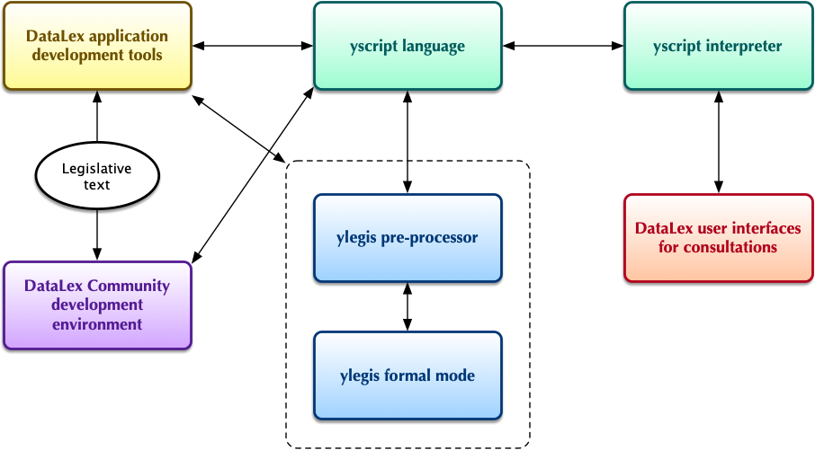
The DataLex system

Slide 24
Building a DataLex test app (1)
Getting started with one simple rule
On the DataLex Community page, under ‘Tutorials, Manuals & Tools
  A Quick Tutorial – use this to start building and testing an app.
  The DataLex Manual – use this to add more refinement and features
Start development at the DataLex Application Development Tools page
  http://www.datalex.org/dev/import/
Import a key section of the Act on which your app is based, and start editing it to make one rule (’RULE xxxxx PROVIDES xxxxxx’)
  Focus on what the section says, not on what it does
  ‘Comment out’ the rest of the section (/* … */)
  Use ‘Run Consultation’ asap, to check the rule works (+ turn on gear wheel)
  Use ‘Check Fact Cross References’ , ‘Check Fact Translations’ & ‘Check Syntax’
  Go back to the Tools page: fix and test; then add another rule

Slide 25
Structure and nature of existing rules
Existing legislation is generally expressed using formal structures containing linked propositions.
Types of proposition include:
  Substantive propositions
  the applicant earns less than $20,000 pa
  Explicit ‘structural’ propositions
  Part II applies
  Implicit ‘structural’ propositions
  section 1(a) applies and section 1(b) applies
  External ‘structural’ propositions
  Company has the same meaning as section 6 of the Corporations Act 2001

Slide 26
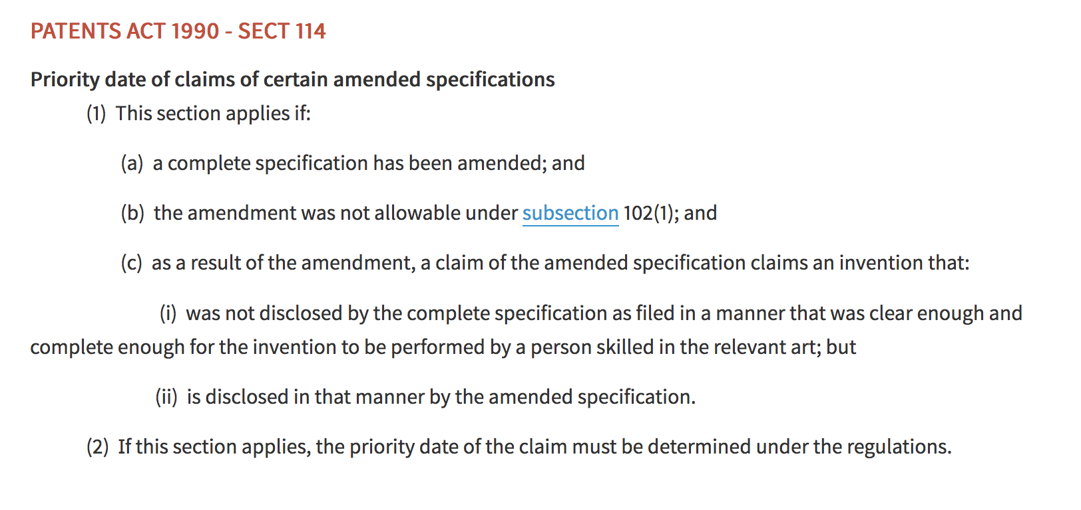
Example: s 114, Patents Act 1990

Slide 27

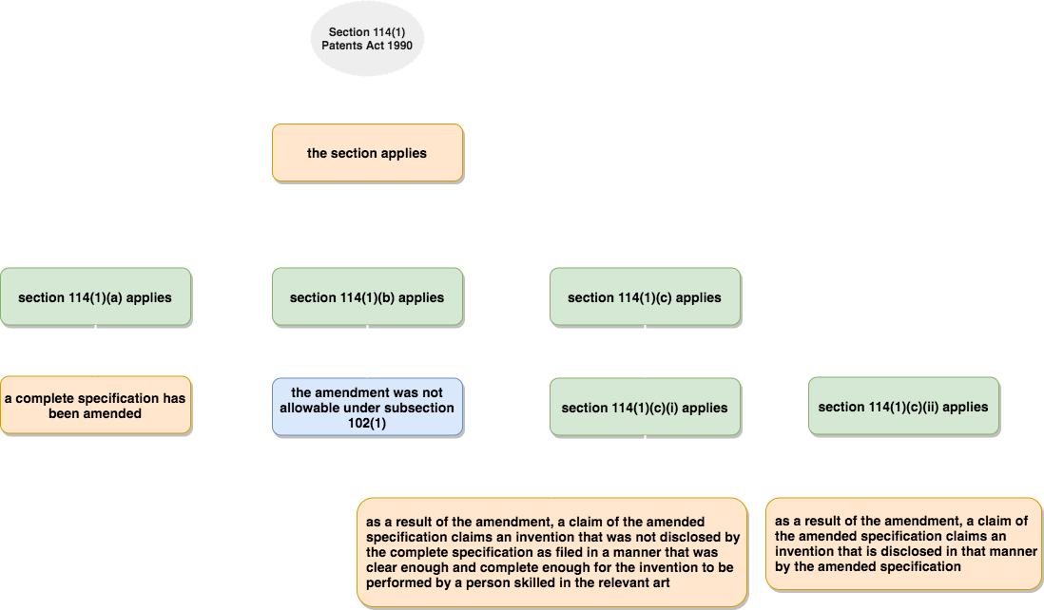
Example: s 114, Patents Act 1990

Slide 28
Building a DataLex test app (2)
Using debugging tools (DataLex Manual part 2.5)
    Demonstration: Go to the FOI consultation again
  Run ‘Check Default Fact Translations’
    Every attribute & named subject found in a KB rule is listed in 3 forms: interrogative; positive assertion; negative assertion
    Check visually to see that they have translated properly
  Run ‘Check Fact Cross References’
    Every attribute and named subject in the KB is listed in alpha order
    The name of each rule in which the attribute is used is listed under it
    Check visually for use in error of similarly named but not identical attributes
  Run ‘Check Syntax’ – gives warnings when keywords used incorrectly
  Observe rules running and transcript consultations . See rules being evaluated as they run (select gear wheel, bottom R)
  Generate a Transcript of whole consultation (text or visual)

Slide 29
Building a DataLex test app (3)
Adding some extra features
Try to add the following features to your app.
  At least one Keyword in addition to ONLYIF
  Make at least one rule a GOAL RULE
  At least one Named Subject (PERSON, THING etc)
  Include the full Act Name (including year) and section, in a rule (not just in its title), so as to automatically create a link to it
  Use LINK … TO … to manually create another link
  Look at the Manual, to find more Keywords that would be useful
Copy the text of your app from the KB Tools page to a Word file, email, or other method of keeping a copy, in case you want to use it again. You can’t save it from the KB Tools page

Slide 30
Building a DataLex test app (4)
The ylegis pre-processor [Optional]
The newest software in the DataLex tools is the ylegis pre-processor, by which legislative provisions may be converted directly to yscript code, without any editing
Simply import one or more sections of an Act into the application window and select the ylegis button.
How well does it work? Read the two-page explanation ‘The DataLex legislation pre-processor for rules as code’. Decide whether the yscript code produced by ylegis needs modification.

Slide 31
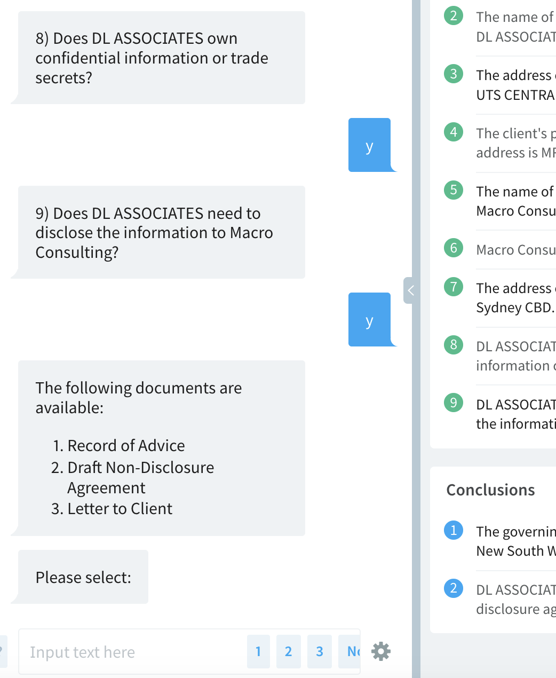
Document Assembly
DataLex supports the integrated generation of documents related to consultations
Document assembly can be based on rules or templates or a combination of both
Example: Non-Disclosure Agreement (NDA)
  See NDA Codebase
Alternative end-user interfaces:
  Run Consultation (Developers UI)
  Run Consultation (Card UI)
Simple example that generates an NDA and supporting documents

Slide 32
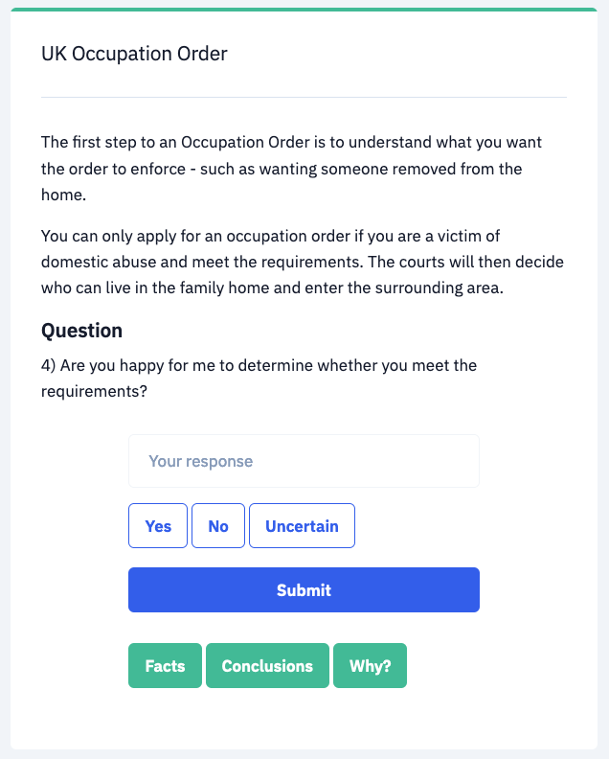
Chatbots
DataLex can also be used to build chatbots and other decision-tree-based systems
Example: UK Occupation Orders (Codebase)
Multiple end-user interfaces:
  Developers Interface
  Card Interface
This example is based on a system built by Aoife Moore (Open University Law School Digital Justice Project) concerning Occupation Orders under ss33-38 of the UK Family Law Act 1996

Slide 33
What can you do next with DataLex?
Continue developing test apps using the DataLex Applications Development Tools page – no commercial uses
Limited AustLII email assistance with queries is available for CLE attendees
  Andrew Mowbray – Andrew@austlii.edu.au
  Graham Greenleaf - graham@austlii.edu.au
  Philip Chung - philip@austlii.edu.au
  General DataLex feedback - datalex@austlii.edu.au
If significant projects using DataLex are desired, discuss with AustLII to obtain a log-in to the DataLex pages on AustLII Communities
  Projects can be saved, and other advantages, in Communities

Slide 34
DataLex References
AustLII Communities: DataLex http://austlii.community/wiki/DataLex/ – key DataLex papers, manuals etc
Greenleaf, Mowbray & Chung, ‘The Datalex Project: History and Bibliography’ (2018) https://ssrn.com/abstract=3095897
  or see linked bibliography at http://www2.austlii.edu.au/~graham/expert_systems.html

